Slide 1
Decision Tree

Slide 2
What is a decision tree?
A flowchart/graph that resembles a tree and uses the method of branching or partitioning the data set by selecting the most significant variable recursively.

Slide 3
Root Node
X1
Branch Node
X4
X5
X3
X2
X6
X6
Branch
X6
X6
Leaf Node

Slide 4
Age | Gender | Marital status | No: of credit cards | Profitable
36 | M | M | 1 | Y
32 | M | S | 3 | N
38 | M | M | 2 | Y
40 | M | S | 1 | N
44 | M | M | 0 | Y
56 | F | M | 0 | Y
58 | F | S | 1 | N
30 | F | S | 2 | Y
28 | F | M | 1 | N
26 | F | M | 0 | N

Slide 5
Age | Gender | Marital status | No: of credit cards | Profitable
36 | M | M | 1 | Y
32 | M | S | 3 | N
38 | M | M | 2 | Y
40 | M | S | 1 | N
44 | M | M | 0 | Y
56 | F | M | 0 | Y
58 | F | S | 1 | N
30 | F | S | 2 | Y
28 | F | M | 1 | N
26 | F | M | 0 | N
25 | M | S | 2 | ?

Slide 6
Total Profitable | 10
Yes | 5
No | 5
Profitable rate | 50%
Age>35
Age<=35
Total Profitable | 6
Yes | 4
No | 2
Profitable rate | 66%
Total Profitable | 4
Yes | 1
No | 3
Profitable rate | 25%
Married
Single
Total Profitable | 4
Yes | 4
No | 0
Profitable rate | 100%
Total Profitable | 2
Yes | 0
No | 2
Profitable rate | 0%
Married people of age >35 are tend to be profitable

Slide 7
Assumptions
At the start, the whole training set is considered as the root.
Feature values are preferred to be categorical. If the values are continuous then they are binned before building the model.
Records are distributed recursively based on attribute values.
Order of placing attributes as root or internal node of the tree is done by using some statistical approach.

Slide 8
Algorithm | Statistical approach
Iterative Dichotomiser (ID3) | Entropy, Information gain (IG)
Classification and regression trees (CART) | Gini Index
Chi-square automatic interaction detector (CHAID) | Chi-square
Gini impurity
Gain Ratio
Reduction in Variance

Slide 9
Entropy & Information gain
Entropy is the degree of randomness
Information gain measures impurity of dataset
Information gain = 1- Entropy

Slide 10
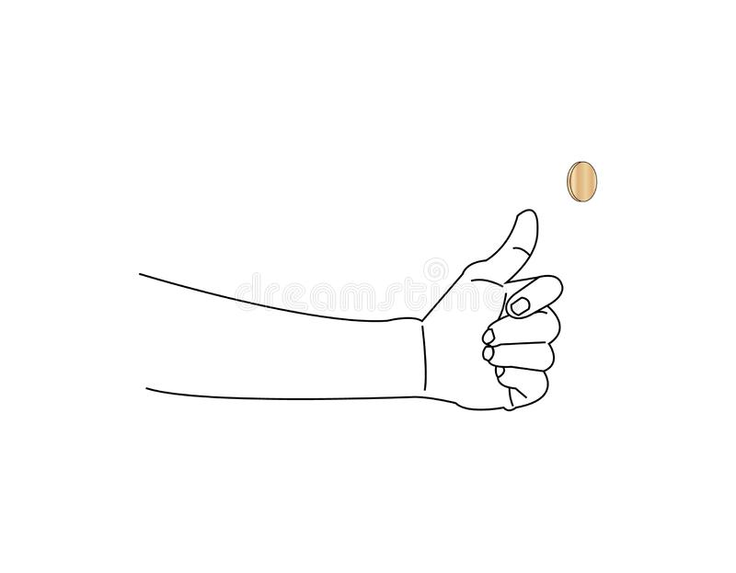
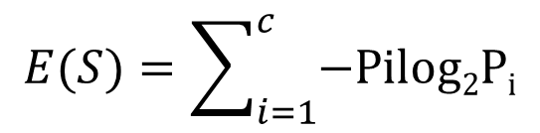
Entropy
High entropy
X1 | X2 | X3 | X4 | X5
0.65 | 0.35 | 0.5 | 0.47 | 0.55
$$E(S)=\sum_{i=1}^{c}{−Pilog2Pi}$$
Where, S - current state
P_{i} - probability of an event I of state S

Slide 11
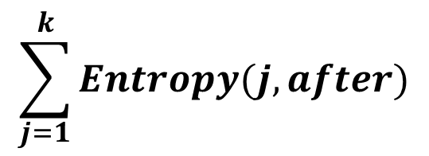
Information gain
High IG
+ +
+ +
+ + +
+ -
+ -
+ - +
+ - *
* - *
+ - +
Pure Impure Highly impure
$$\sum_{j=1}^{k}{Entropy(j,after)}$$
Information gain =
Entropy(before) –

Slide 12
Gini Index
It is opposite to information gain
This measures the purity of the dataset.

Slide 13

Gini Index
Highly Pure
P(blue) = 1
P(Red) = 0
P(blue) = 2/3
P(Red) = 1/3
Gini index = (1)² + (0)² = 1 or 100% pure
Gini index = (1/3)² + (2/3)² = 0.55 or 55% pure
CART ( Classification and Regression trees)
Gini = 1 – $\sum_{i=1}^{c}{(Pi)2}$

Slide 14
chi-square automatic interaction detector (CHAID)

Slide 15
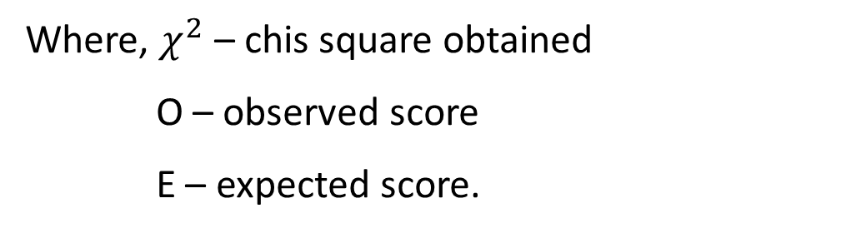
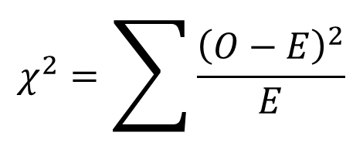
chi-square
Chi-square test for significance
Chi-square test for association
$$χ^{2}=\sum{\frac{{\left(O−E\right)}^{2}}{E}}$$
Where, $χ^{2}$ – chis square obtained
O – observed score
E – expected score.

Slide 16
CHAID
X1
Chi-square significance score reduces
X4
X5
Parent node
X3
X2
X6
X6
Child node
X6
X6

Slide 17
Gender | Class | Height | Play Cricket
Male | Class9 | 6.7 | Yes
Female | Class10 | 5.5 | Yes
Male | Class9 | 5.6 | No
Female | Class10 | 4.5 | No
Female | Class10 | 4.4 | No
Female | Class10 | 5.2 | No
Female | Class9 | 4.3 | No
Female | Class9 | 5.3 | Yes
Female | Class9 | 4.6 | No
Female | Class9 | 4.5 | No
Female | Class9 | 4.7 | No
Female | Class9 | 4.8 | No
Male | Class10 | 5.9 | Yes
Male | Class10 | 6.3 | Yes
Male | Class10 | 6.1 | No
Male | Class10 | 5.8 | Yes
Male | Class10 | 5.7 | Yes
Male | Class10 | 5.6 | Yes
Male | Class10 | 5.9 | No
Male | Class10 | 5.7 | No
Male | Class10 | 5.5 | No
Male | Class9 | 5.8 | Yes
Male | Class9 | 6.2 | Yes
Male | Class9 | 5.7 | Yes
Male | Class9 | 5.6 | Yes
Male | Class9 | 5.4 | Yes
Male | Class9 | 5.5 | Yes
Male | Class10 | 6.4 | No
Male | Class10 | 5.8 | Yes
Male | Class10 | 5.6 | No

Slide 18
Students(30)
Play cricket(15)
Split on Gender
Split on Class
Split on Height
Female
Male
Class 9
Class 10
<5.5 ft
>=5.5ft
Students
(10)
Play
(2)
Students
(20)
Play
(13)
Students
(14)
Play
(6)
Students
(16)
Play
(9)
Students
(12)
Play
(5)
Students
(18)
Play
(10)

Slide 19
Gender Split
 |  |  |  |  |  |  |  | chi-square
Node | Observed Play cricket | observed Not play cricket | Total | Expected Play cricket | Expected not play cricket | Variance play cricket | variance not play cricket | Play cricket | not play cricket

Slide 20
Gender Split
 |  |  |  |  |  |  |  | chi-square
Node | Observed Play cricket | observed Not play cricket | Total | Expected Play cricket | Expected not play cricket | Variance play cricket | variance not play cricket | Play cricket | not play cricket
Female
Male

Slide 21
Gender Split
 |  |  |  |  |  |  |  | chi-square
Node | Observed Play cricket | observed Not play cricket | Total | Expected Play cricket | Expected not play cricket | Variance play cricket | variance not play cricket | Play cricket | not play cricket
Female | 2 | 8 | 10
Male

Slide 22
Gender Split
 |  |  |  |  |  |  |  | chi-square
Node | Observed Play cricket | observed Not play cricket | Total | Expected Play cricket | Expected not play cricket | Variance play cricket | variance not play cricket | Play cricket | not play cricket
Female | 2 | 8 | 10
Male | 13 | 7 | 20

Slide 23
Gender Split
 |  |  |  |  |  |  |  | chi-square
Node | Observed Play cricket | observed Not play cricket | Total | Expected Play cricket | Expected not play cricket | Variance play cricket | variance not play cricket | Play cricket | not play cricket
Female | 2 | 8 | 10 | 5 | 5
Male | 13 | 7 | 20

Slide 24
Gender Split
 |  |  |  |  |  |  |  | chi-square
Node | Observed Play cricket | observed Not play cricket | Total | Expected Play cricket | Expected not play cricket | Variance play cricket | variance not play cricket | Play cricket | not play cricket
Female | 2 | 8 | 10 | 5 | 5
Male | 13 | 7 | 20 | 10 | 10

Slide 25
Gender Split
 |  |  |  |  |  |  |  | chi-square
Node | Observed Play cricket | observed Not play cricket | Total | Expected Play cricket | Expected not play cricket | Variance play cricket | variance not play cricket | Play cricket | not play cricket
Female | 2 | 8 | 10 | 5 | 5 | 2-5= -3
Male | 13 | 7 | 20 | 10 | 10 | 13-10 = 3

Slide 26
Gender Split
 |  |  |  |  |  |  |  | chi-square
Node | Observed Play cricket | observed Not play cricket | Total | Expected Play cricket | Expected not play cricket | Variance play cricket | variance not play cricket | Play cricket | not play cricket
Female | 2 | 8 | 10 | 5 | 5 | 2-5= -3 | 5-2 = 3
Male | 13 | 7 | 20 | 10 | 10 | 13-10 = 3 | 10-13 = -3

Slide 27
Gender Split
 |  |  |  |  |  |  |  | chi-square
Node | Observed Play cricket | observed Not play cricket | Total | Expected Play cricket | Expected not play cricket | Variance play cricket | variance not play cricket | Play cricket | not play cricket
Female | 2 | 8 | 10 | 5 | 5 | 2-5=-3 | 5-2 = 3 | ((-3)²)/5 = 1.8 | ((3)²)/5 = 1.8
Male | 13 | 7 | 20 | 10 | 10 | 13-10 = 3 | 10-13 = -3 | ((3)²)/10 = 0.9 | ((-3)²)/10 = 0.9

Slide 28
Gender Split
 |  |  |  |  |  |  |  | chi-square
Node | Observed Play cricket | observed Not play cricket | Total | Expected Play cricket | Expected not play cricket | Variance play cricket | variance not play cricket | Play cricket | not play cricket
Female | 2 | 8 | 10 | 5 | 5 | 2-5=-3 | 5-2 = 3 | ((-3)²)/5 = 1.8 | ((3)²)/5 = 1.8
Male | 13 | 7 | 20 | 10 | 10 | 13-10 = 3 | 10-13 = -3 | ((3)²)/10 = 0.9 | ((-3)²)/10 = 0.9
 |  |  |  |  |  |  |  | Total Chi -Square = 1.8+0.9+1.8+0.9 = 5.4

Slide 29
Gender Split
 |  |  |  |  |  |  |  | chi-square
Node | Observed Play cricket | observed Not play cricket | Total | Expected Play cricket | Expected not play cricket | Variance play cricket | variance not play cricket | Play cricket | not play cricket
Female | 2 | 8 | 10 | 5 | 5 | 2-5=-3 | 5-2 = 3 | ((-3)²)/5 = 1.8 | ((3)²)/5 = 1.8
Male | 13 | 7 | 20 | 10 | 10 | 13-10 = 3 | 10-13 = -3 | ((3)²)/10 = 0.9 | ((-3)²)/10 = 0.9
 |  |  |  |  |  |  |  | Total Chi -Square = 1.8+0.9+1.8+0.9 = 5.4
Class Split
 |  |  |  |  |  |  |  | chi-square
Node | Observed Play cricket | observed Not play cricket | Total | Expected Play cricket | Expected not play cricket | Variance play cricket | variance not play cricket | Play cricket | not play cricket
class 9 | 6 | 8 | 14 | 7 | 7 | -1 | 1 | 0.142857143 | 0.142857143
class 10 | 9 | 7 | 16 | 8 | 8 | 1 | -1 | 0.125 | 0.125
 |  |  |  |  |  |  |  | Total Chi -Square = 0.53
Height Split
 |  |  |  |  |  |  |  | chi-square
Node | Observed Play cricket | observed Not play cricket | Total | Expected Play cricket | Expected not play cricket | Variance play cricket | variance not play cricket | Play cricket | not play cricket
<5.5ft | 5 | 7 | 12 | 6 | 6 | -1 | 1 | 0.166666667 | 0.166666667
>5.5ft | 10 | 8 | 18 | 9 | 9 | 1 | -1 | 0.111111111 | 0.111111111
 |  |  |  |  |  |  |  | Total Chi -Square = 0.55

Slide 30
Split on Gender
Female
Male
Split on class
Split on Height
Split on class
Split on Height
Class 9
Class 10
>=4.5
Class 9
Class 10
<4.5
>=4.5
<4.5
Students(6)
Play
(1)
Students(4)
Play
(1)
Students(2)
Play
(0)
Students(10)
Play
(2)
Students(8)
Play
(7)
Students(12)
Play
(6)
Students(15)
Play
(10)
Students(5)
Play
(3)

Slide 31
When and What?
Target variable | Input variable | Splits | Statistical approach
Categorical | Continuous | Binary | Gini index
Categorical | Categorical/continuous | Multiple | Chi-square
Continuous | Categorical/continuous | Multiple | Reduction in variance

Slide 32
Pros:
Easy to interpret
Variable selection is easy
Decision tree is a non-parametric statistical approach
Works for both continuous and categorical variables
Cons:
Decision tree often over fits

Slide 33
How to overcome overfitting?
Pruning
Ensemble learning techniques:
Random forest
Bagging
Boosting

